Slide 1


Training Deck
Agenda:
Aura / Lightning Components

Slide 2
Agenda
Why Lightning
Lightning App Builder
Lightning Experience Builder
Overview of Lightning Component Framework
Base / Standard Lightning Components
Custom Lightning Component Development
Lightning Data Service

Slide 3
Why Lightning
Avoid Server Calls
Faster Development
Infinite or Lazy Loading
Responsiveness
etc
Link : https://developer.salesforce.com/docs/atlas.en-us.lightning.meta/lightning/intro_benefits.htm
Link (Infinite or Lazy Loading) : https://developer.salesforce.com/docs/component-library/bundle/lightning:datatable/example#lightningcomponentdemo:exampleDatatableInfiniteLoading

Slide 4
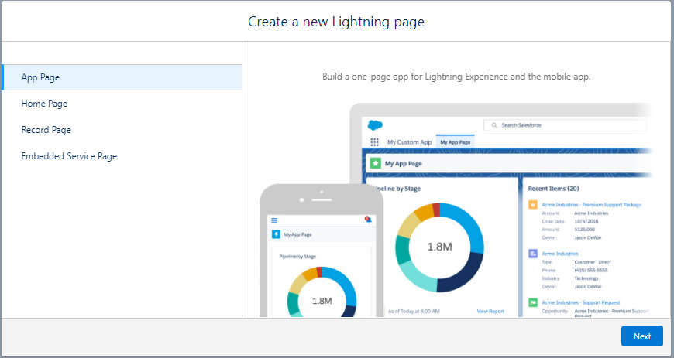
Lightning App Builder
Needed to create Flexi Pages
App Page – Used for creating a Lightning Application page
Home Page – Used in the “Home” tab
Record Page – Used for any record page like Account record, Contact record, etc.
Embedded Service Page – Used in the Chat window.
Link : https://help.salesforce.com/s/articleView?id=sf.lightning_app_builder_overview.htm&type=5
Trailhead: https://trailhead.salesforce.com/content/learn/modules/lightning_app_builder

Slide 5
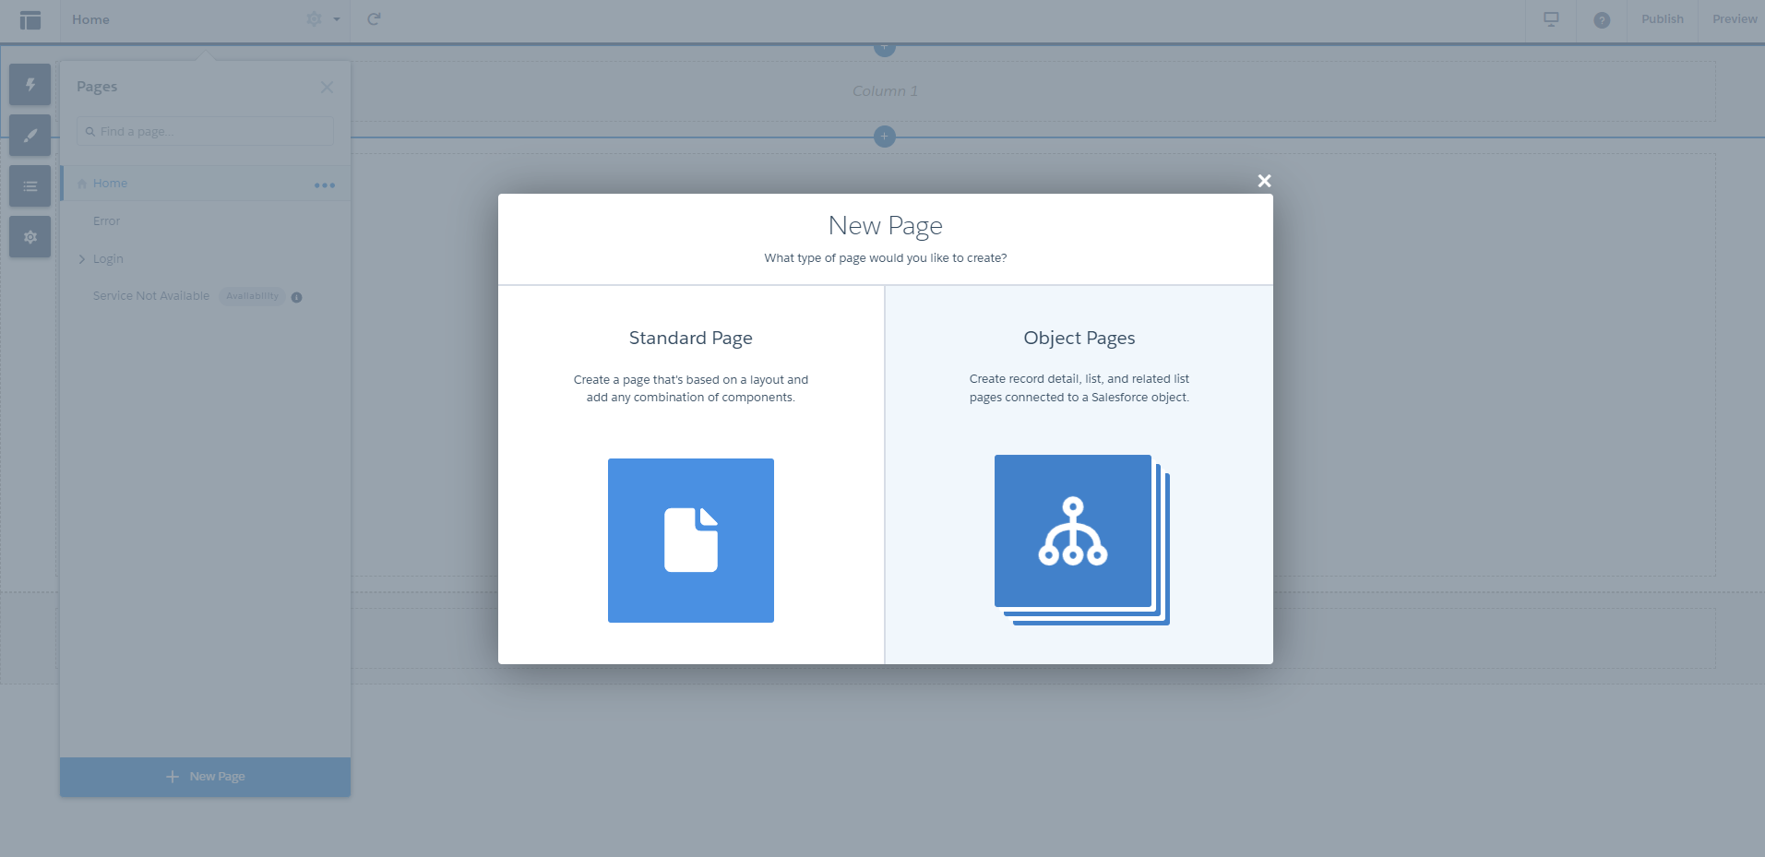
Lightning Experience Builder
Needed to create a community
Used to create Flexi pages in community
Object Page : Needed to create a record detail page.
Standard Page : Needed to create any page other than record detail page.
Link : https://help.salesforce.com/s/articleView?id=sf.community_designer_overview.htm&type=5
Trailhead:
https://trailhead.salesforce.com/content/learn/modules/community_cloud_basics?trailmix_creator_id=frankklensch&trailmix_slug=lightning-communities
Trailhead:
https://trailhead.salesforce.com/content/learn/projects/communities_theme_layout

Slide 6
Overview of Lightning Component Framework
Follows Single Page Application architecture
Based on HTML5, JavaScript, and CSS3
Follows MVCC Design pattern
Stateful Client, Stateless Server
Supports Responsive Design
Link (Stateful Client, Stateless Server): https://salesforce.stackexchange.com/questions/296098/in-salesforce-lightning-client-side-is-stateful-and-server-side-is-stateless-wh

Slide 7
Base / Standard Lightning Components
OOTB Lightning Components provided by Salesforce.
Used to create Custom Lightning Components.
Type “Lightning Component Library” in Google browser or directly go to https://developer.salesforce.com/docs/component-library/overview/components

Slide 8
Custom Lightning Component Development
Lightning Component Bundle
Controllers in Lightning Components
Understanding helper.js
Custom css
Renderer in Lightning Components
Design attribute in Lightning Components
Trailhead:
https://trailhead.salesforce.com/content/learn/modules/lex_dev_lc_basics?trailmix_creator_id=jvillaceran&trailmix_slug=p4u-lightning-component-development-basics
Lightning Interface
Attributes in Lightning Component
Salesforce Lightning Design System (SLDS)
Inheritance in Lightning Components
Lightning Action Override
Lightning Quick Action
Trailhead:
https://trailhead.salesforce.com/content/learn/projects/quickstart-lightning-components

Slide 9
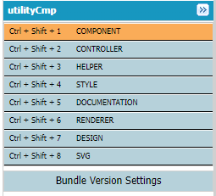
Lightning Component Bundle
COMPONENT.cmp
CONTROLLER.js
HELPER.js
STYLE.css
DOCUMENTATION.auradoc
RENDERER.js
DESIGN.design
SVG.svg
Link : https://developer.salesforce.com/docs/atlas.en-us.lightning.meta/lightning/components_bundle.htm

Slide 10
Controllers in Lightning Components
Controllers can be of two types
JS Controller
A part of the Lightning Component Bundle
Action handlers are written in js controller
Reusable functions should not be added in js controller
Calling a controller function from another controller function is complex
Apex Controller – It is an Apex Class

Slide 11
Understanding helper.js
Reusable functions should be written in helper.js file
Calling a helper function from another helper function or controller function is very easy
It is a good practice to call an Apex Controller function from a helper function
Link: https://developer.salesforce.com/docs/atlas.en-us.lightning.meta/lightning/js_helper.htm#:~:text=Helper%20functions%20are%20local%20to,client%2Dside%20controller%20or%20renderer.

Slide 12
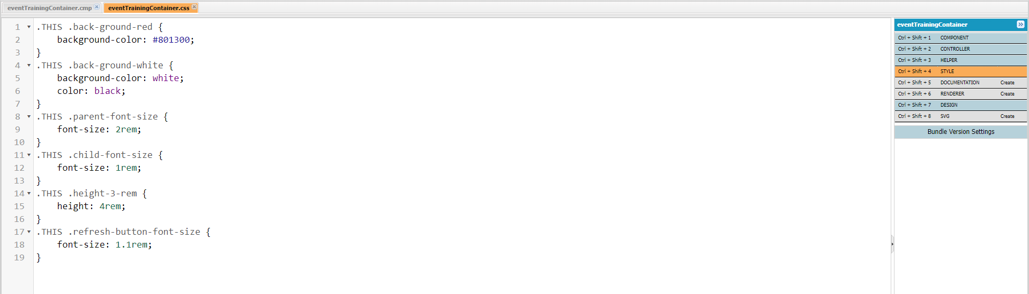
Custom css
To apply some required style which is unachievable using SLDS, we should create custom css classes.
Link: https://developer.salesforce.com/docs/atlas.en-us.lightning.meta/lightning/components_css.htm

Slide 13
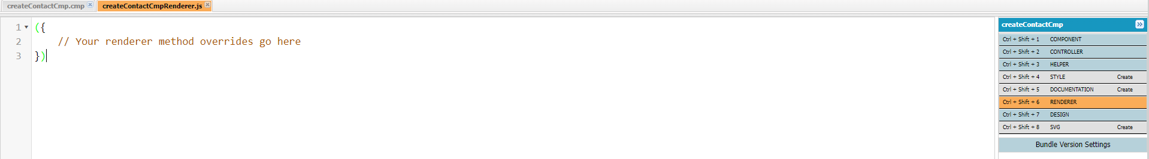
Renderer in Lightning Components
Renderer service in lightning component bundle modifies the DOM elements
Custom renderer is used to change or override the default rendering behavior of the component
Helper function can be called from a renderer function
Link: https://developer.salesforce.com/docs/atlas.en-us.lightning.meta/lightning/js_renderers.htm

Slide 14
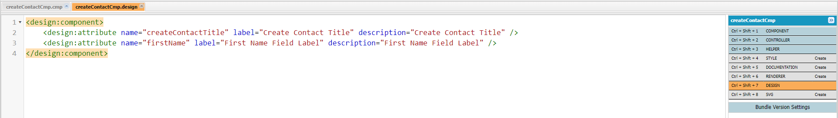
Design attribute in Lightning Components
It is a part of Lightning Component Bundle
Used to make a lightning component attribute available for admins to edit in Lightning App Builder or Experience Builder
Link: https://developer.salesforce.com/docs/atlas.en-us.lightning.meta/lightning/components_config_for_app_builder_design_files.htm

Slide 15
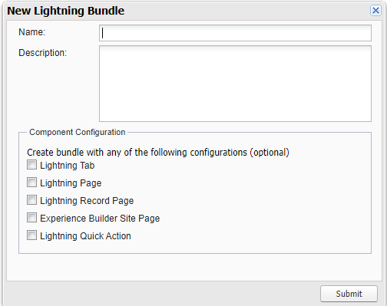
Lightning Interface
It enables the accessibility of Lightning Components at different places in Lightning Experience.
Checking the boxes in the screenshot shown, includes the interfaces automatically in Lightning component.
Some Important Interfaces:
force:hasRecordId
force:hasSObjectName
flexipage:availableForAllPageTypes
flexipage:availableForRecordHome
forceCommunity:availableForAllPageTypes
force:lightningQuickAction
lightning:actionOverride
Link: https://developer.salesforce.com/docs/component-library/overview/interfaces

Slide 16
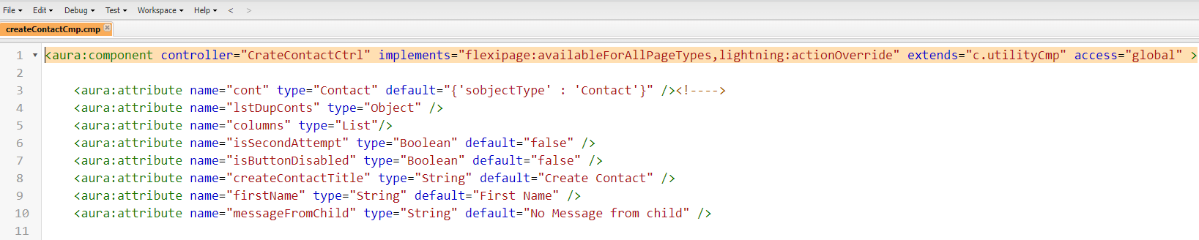
Attributes in Lightning Component
Component attributes are like member variables on a class in Apex
All attributes have a name and type
Link: https://developer.salesforce.com/docs/atlas.en-us.lightning.meta/lightning/components_attributes.htm#:~:text=Component%20attributes%20are%20like%20member,to%20make%20components%20more%20dynamic.&text=All%20attributes%20have%20a%20name%20and%20a%20type.

Slide 17
Salesforce Lightning Design System (SLDS)
Native css framework
Provides similar experience like Bootstrap
Provides a consistent look and feel with LEX
Provides OOTB icons to use in custom lightning component development
Link: https://www.lightningdesignsystem.com/
Link (SLDS Icons): https://www.lightningdesignsystem.com/icons/
Trailhead: https://trailhead.salesforce.com/content/learn/modules/lightning-design-system-development-for-designers

Slide 18
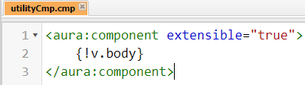
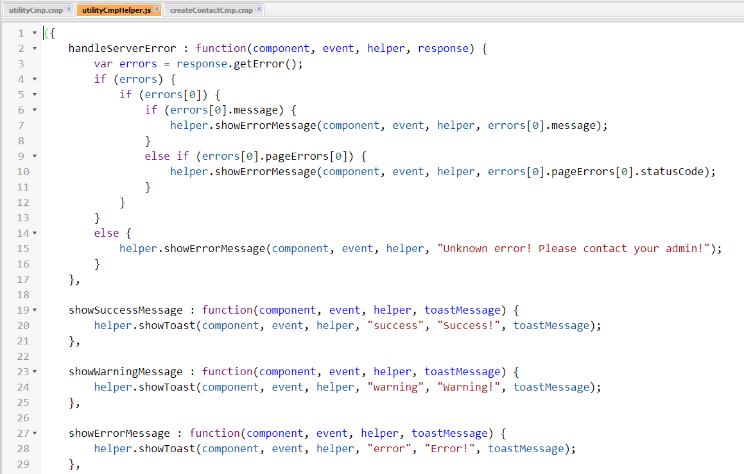
Inheritance in Lightning Components
A component using extensible=“true” can be extended by any other Lightning Component
Globally reusable functions can be put in the helper.js of extensible Component.
Favor Composition over Inheritance
Link: https://developer.salesforce.com/docs/atlas.en-us.lightning.meta/lightning/oo_cmp_attributes.htm
Link: https://developer.salesforce.com/docs/atlas.en-us.lightning.meta/lightning/oo_favor_composition.htm

Slide 19
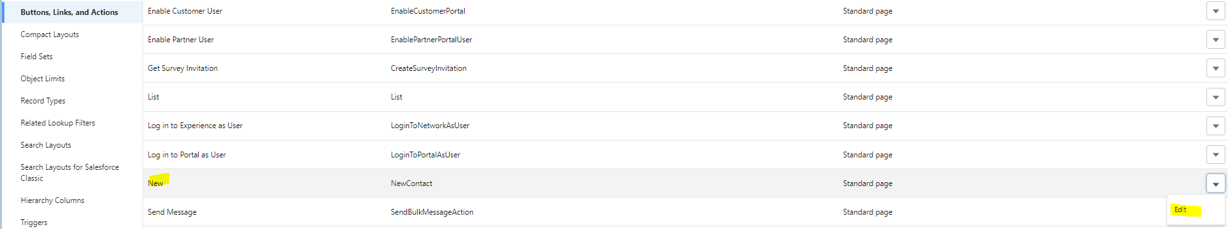
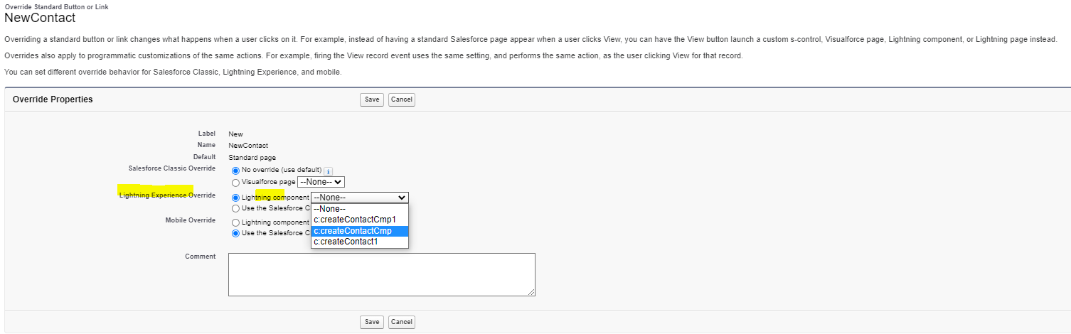
Lightning Action Override
The default behavior of a Standard button can be overridden using a Lightning Component with the concept of “Lightning Action Override”
The lightning component should implement lightning:actionOverride interface for this functionality
Link: https://developer.salesforce.com/docs/component-library/bundle/lightning:actionOverride/documentation

Slide 20
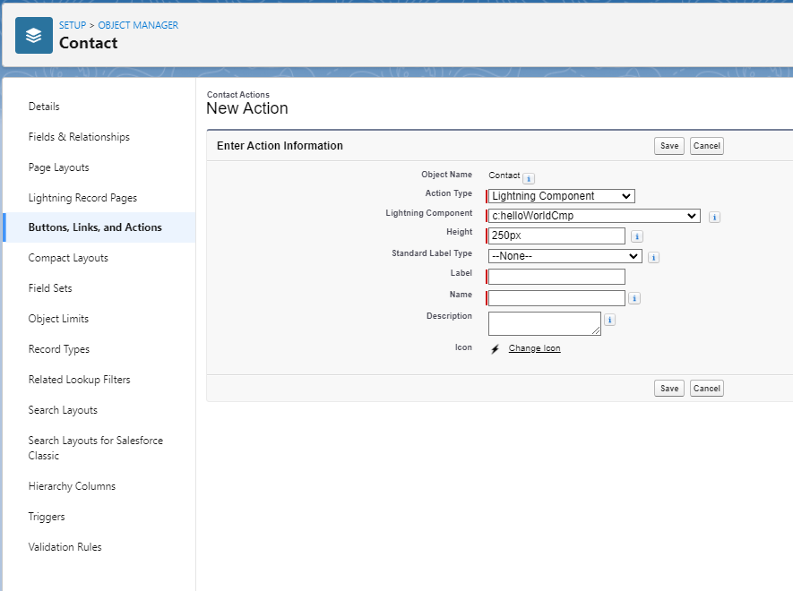
Lightning Quick Action
We can create a Lightning Action and open a Lightning component on click of it
force:lightningQuickAction interface should be added to a Lightning component to allow it to be used as a custom action
Link: https://developer.salesforce.com/docs/component-library/bundle/force:lightningQuickAction/documentation

Slide 21
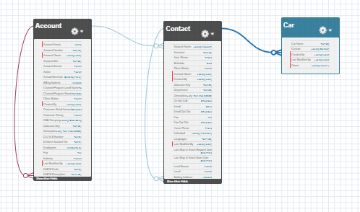
Sample Use Case
An organization (Account) allows their employees (Contact) to use company Cars (Car__c). The Organization wants to see the list of employees and the Cars, they are using in a tabular format in the Account record page.
Link (Calling Apex controller from Lightning Component): https://developer.salesforce.com/docs/atlas.en-us.lightning.meta/lightning/controllers_server_actions_call.htm

Slide 22
Lightning Data Service (LDS)
Load, Create, Edit, or Delete a record without requiring Apex code
Handles Sharing Rules and Field Level Security automatically
Base Lightning Components for LDS
lightning:recordForm
lightning:recordViewForm
lightning:recordEditForm
Link (lightning:recordForm) : https://developer.salesforce.com/docs/component-library/bundle/lightning:recordForm/documentation
Link (lightning:recordViewForm) : https://developer.salesforce.com/docs/component-library/bundle/lightning:recordViewForm/documentation
Link (lightning:recordEditForm) : https://developer.salesforce.com/docs/component-library/bundle/lightning:recordEditForm/documentation

Slide 23
Load record using LDS
lightning:recordForm
lightning:recordViewForm
Use the lightning:recordForm component to quickly create forms to view a record
Switches between view and edit modes automatically when the user begins editing a field in a view form
Provides default Cancel and Save buttons in edit forms
Uses the object's default record layout with support for multiple columns
Loads all fields in the object's compact or full layout, or only the fields you specify
Use the lightning:recordViewForm component to create a form that displays Salesforce record data for specified fields associated with that record
lightning:recordForm is less customizable. To customize the form layout or provide custom rendering of record data, use lightning:recordViewForm to view a record

Slide 24
Create/Edit record using LDS
lightning:recordForm
lightning:recordEditForm
Use the lightning:recordForm component to quickly create forms to view a record
Switches between view and edit modes automatically when the user begins editing a field in a view form
Provides default Cancel and Save buttons in edit forms
Uses the object's default record layout with support for multiple columns
Loads all fields in the object's compact or full layout, or only the fields you specify
Use the lightning:recordEditForm component to create a form that's used to add a Salesforce record or update fields in an existing record. The component displays fields with their labels and the current values, and enables you to edit their values
Can be used to edit a record's specified fields, given the record ID
Can be used to create a record using specified fields.
To specify editable fields, use lightning:inputField components inside the lightning:recordEditForm component.
To display record fields as read-only, use lightning:outputField components to specify those fields.

Slide 25


